Slide 1
Digitalisation of the Business Processes Business Process : Recommend Study Program Process
Date: 07. June 2018
Authors: Daniel Horn, Daniel Werner, Fabian Feiler, Lia Flück, Puneeth Suresh
Supervisors: Knut Hinkelmann, Andreas Martin, Emanuele Laurenzi, Prajakta Diwanji

Slide 2
Agenda
Introduction
Motivation, Problem Statement & Vision
Process description
Task types
Event types
Users & Groups
Automation & Service Integration
Automation
Service Integration
Demo / User Guide

Slide 3
Introduction

Slide 4

Problem Statement
What study program fits best to me taking into account:
My personality
My education path
My professional experience
My career goals

Slide 5

Motivation
Lia is working as a project manager of the digitalisation project of the sub-process program registration oft the FHNW School of Business.
Perfect opportunity
All project members are at least faced to times in their live with this BIG question and would like to have a decision support tool.

Slide 6


Vision
Bringing the right prospective student with the best fitting study program together to foster the potential and satisfaction for students, study program class environment and therefore as a consequence the society in economics and cultural aspects.

Slide 7
Process Description (top level)
FHNW School of Business Onboarding Process
Recommend Study Program Process
Program Registration Process

Slide 8
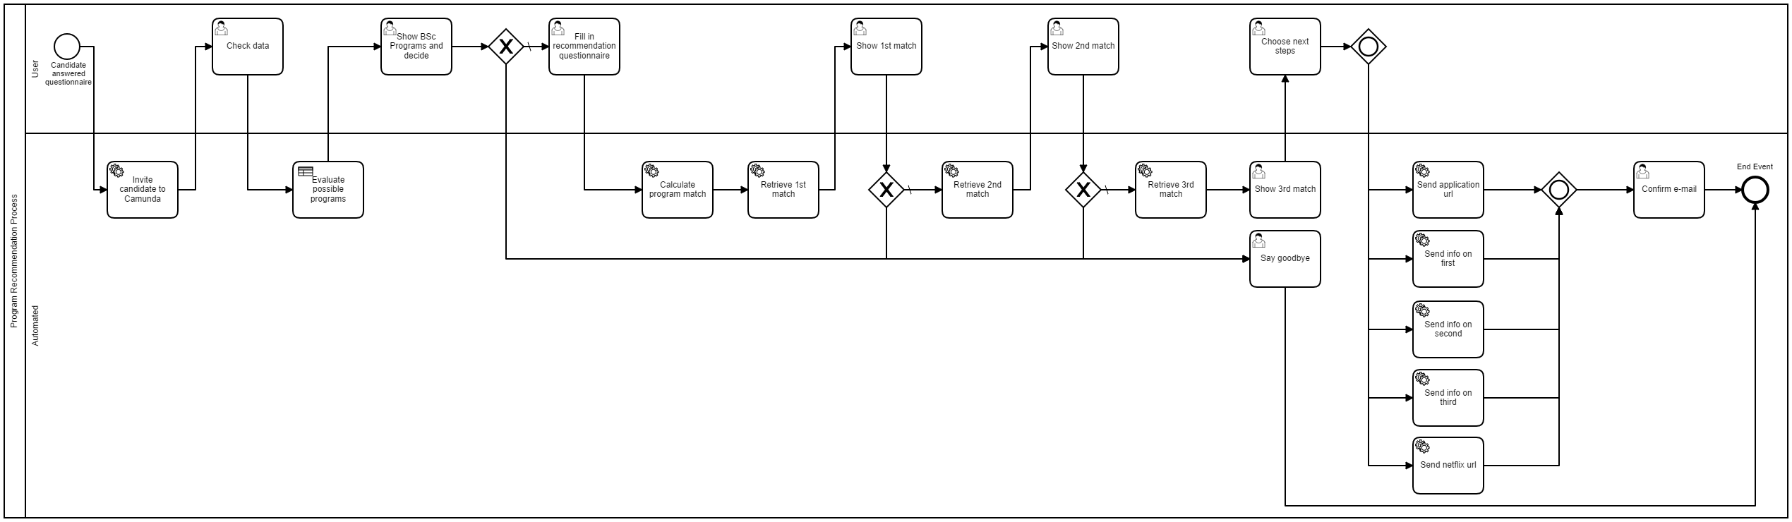
Process Description (complete)

Slide 9
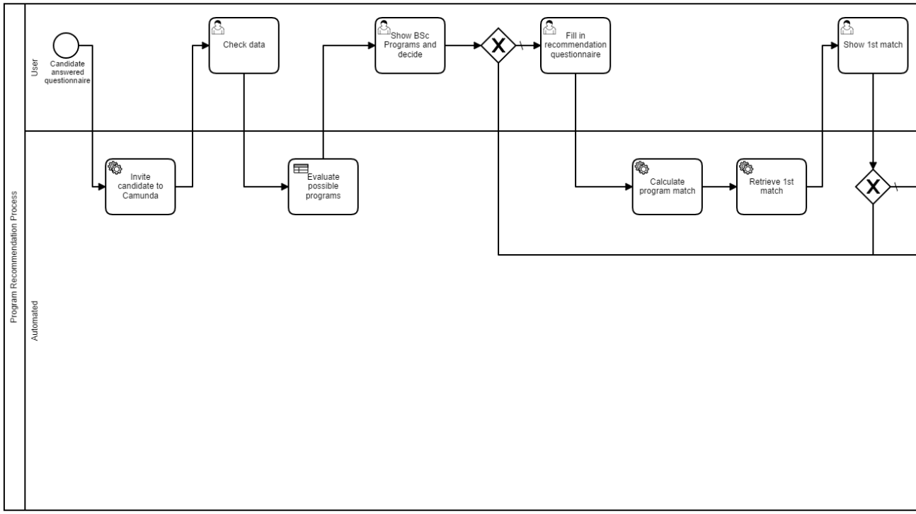
Process Description (1/2)

Slide 10
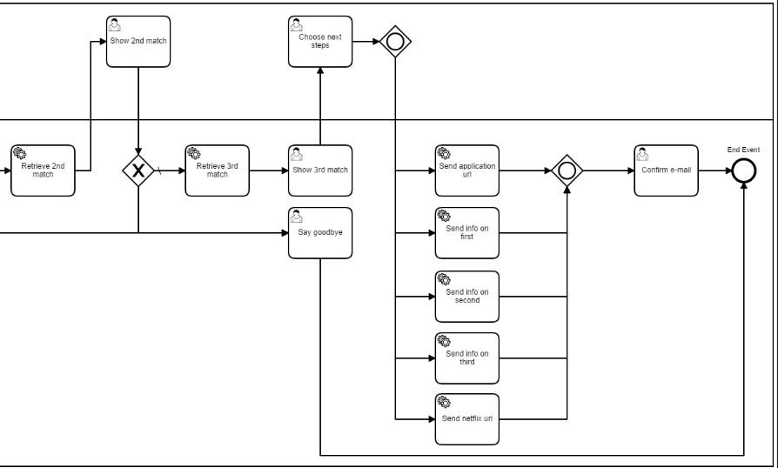
Process Description (2/2)

Slide 11
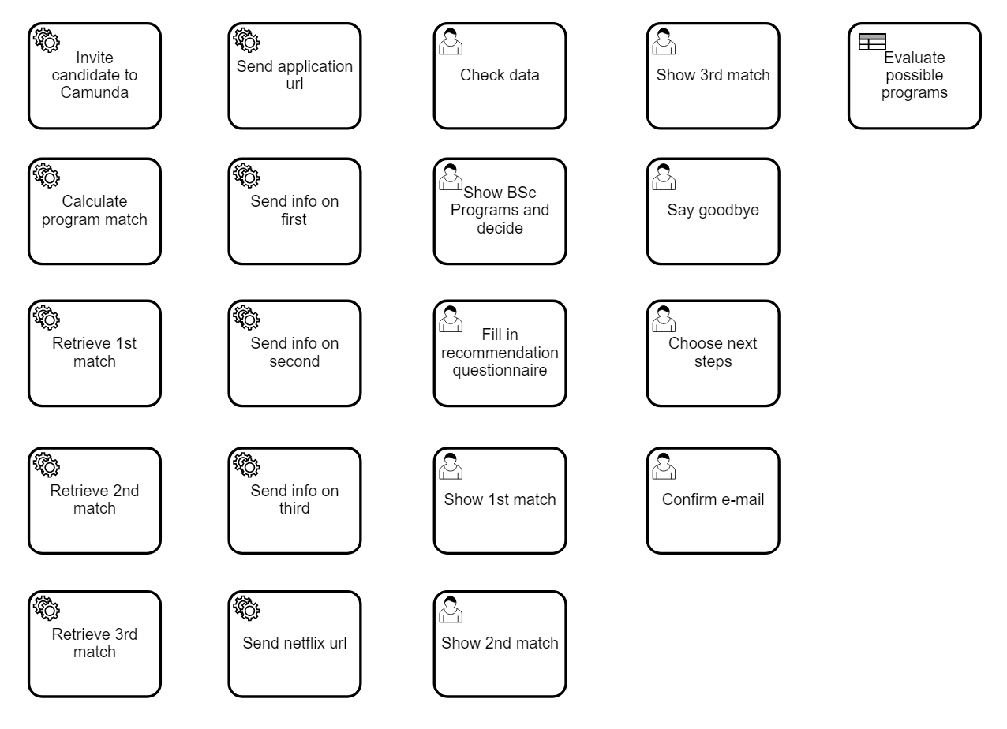
Task Types

Slide 12

Event Types
Start event
Exclusive gateway
Inclusive gateway
End event

Slide 13
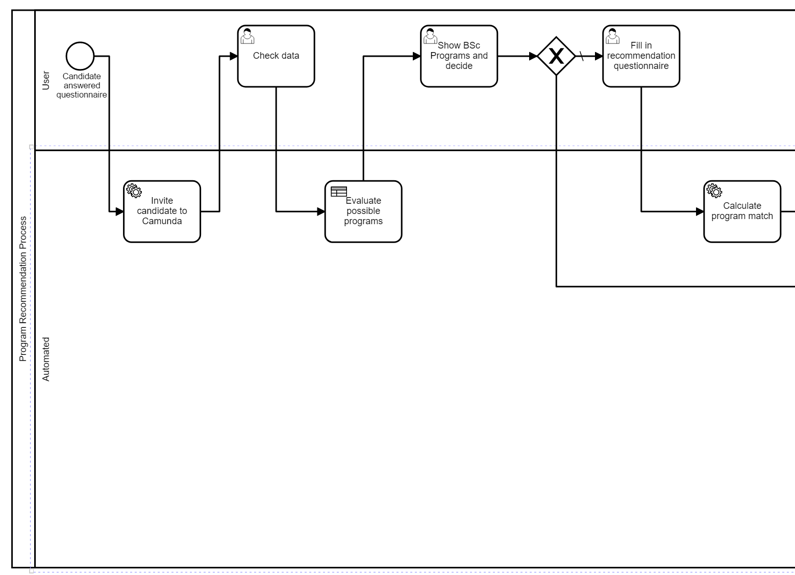
User & Groups
User
Automated

Slide 14
Automation & Service Integration

Slide 15
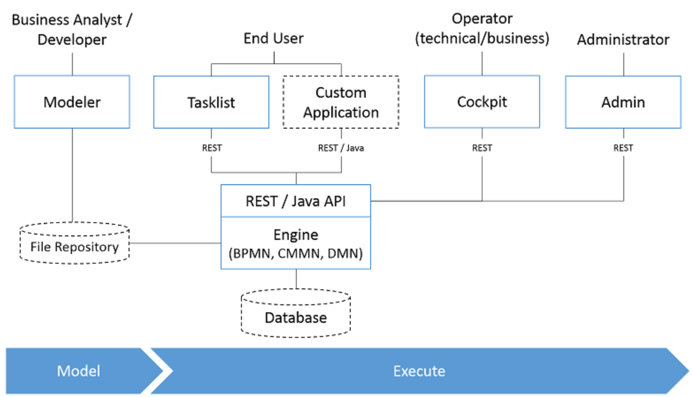
Automation & Service Integration
Wordpress / google form
REST
External services

Slide 16
Demo

